Slide 1
Herpes Simplex Virus Clinical Approaches to STI Management Raj Patel 21st of July 2018

Slide 2
Disclosures
Research grants: GSK, Novartis, Roche, CLJI, Beckton Dickenson
Speaker Panels/Advisory Boards : GSK, Novartis, Roche, BD, Genocea

Slide 3
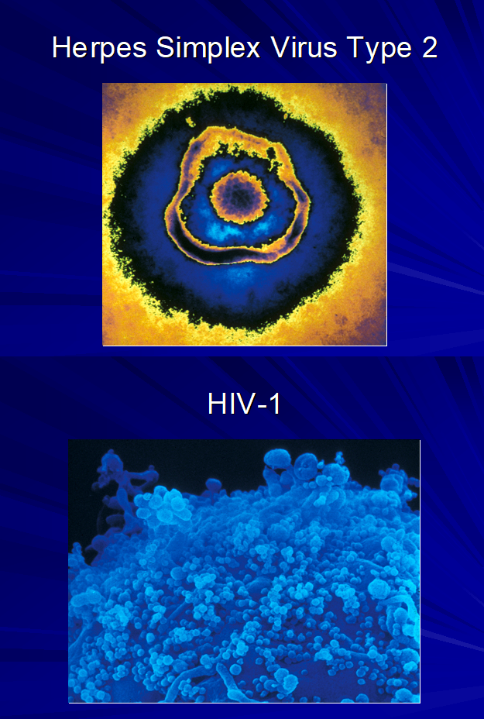
Herpes Simplex Virus
Deadly synergy
Accounts for >30% of new HIV transmissions/acquisitions

Slide 4
Herpes Simplex Virus
Symptoms and signs
Variations in Natural History with HIV co-infection
Treatment Options
Complications, prognosis and clinical management in those with HIV co-infection

Slide 5
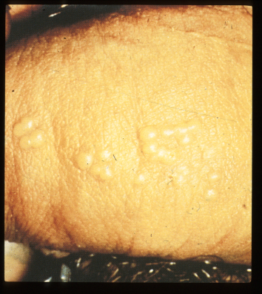
Clinical Genital Herpes Presentation
1st Infection
Latency
No Reactivation
Reactivation
Symptomatic
1st Episode
Clinically recurrent
Disease
Subclinical
Disease

Slide 6
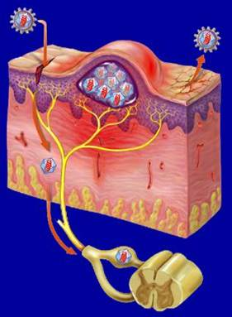
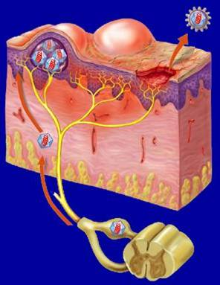
Viral Pathogenesis
Virus
Virus
Reactivated
Virus
Latent Virus
Spinal Cord
Primary Infection
Recurrent Infection
Illustration by FH Netter. ©2001 Icon Learning Systems.
Notes:
References:
Corey L. Herpes simplex virus. In: Mandell GL, Bennett JE, Dolin R, eds. Principles and Practice of Infectious Diseases. 5th ed. Philadelphia, Pa: Churchill Livingstone; 2000:1564-1575.
Whitley RJ. Herpes simplex viruses. In: Knipe DM, Howley PM, eds. Fields Virology. Vol 2. 4th ed. Philadelphia, Pa: Lippincott Williams & Wilkins; 2001:2461-2509.
A unique attribute of the herpesvirus is its characteristic latency, which gives the virus its strong persistent nature.
During the primary infection and while the immune system is trying to fight off the virus, the nerve fibers that supply sensation to the affected areas of the skin also become infected. The virus travels up the nerve until it reaches the core of the cell inside the ganglion.
Unlike the productive and explosive infection of the skin, the herpesvirus lies dormant inside the cell bodies of sensory nerves (latency).
Several copies of the viral DNA, in the form of circles that are extrachromosomal, remain inside latently infected nerve cells without significantly damaging the nerve cells and without activating the body’s immune system.
Factors and stimuli, such as sunlight, stress, menstruation, advancing age, or decreased cellular immunity, may stimulate reactivation.
During reactivation, the herpesvirus travels back down the nerve to the end of the nerve fiber, where it reaches the surface of new healthy skin cells. Then, the active state begins again, and a new recurrent infection takes place.

Slide 7
Initial Infection
Only 25% of initial infections are symptomatic
Symptoms typically 4-7 days after infection
Bilateral, erythema, papules, blisters- ulcers
Associated with local lymphadenopathy and some mild systemic symptoms
Symptoms peak at 11 days and subside usually by 3 weeks – clearance requires an intact, functioning immune system

Slide 8
Viral Pathogenesis
Virus
Virus
Reactivated
Virus
Latent Virus
Spinal Cord
Primary Infection
Recurrent Infection
Illustration by FH Netter. ©2001 Icon Learning Systems.
Notes:
References:
Corey L. Herpes simplex virus. In: Mandell GL, Bennett JE, Dolin R, eds. Principles and Practice of Infectious Diseases. 5th ed. Philadelphia, Pa: Churchill Livingstone; 2000:1564-1575.
Whitley RJ. Herpes simplex viruses. In: Knipe DM, Howley PM, eds. Fields Virology. Vol 2. 4th ed. Philadelphia, Pa: Lippincott Williams & Wilkins; 2001:2461-2509.
A unique attribute of the herpesvirus is its characteristic latency, which gives the virus its strong persistent nature.
During the primary infection and while the immune system is trying to fight off the virus, the nerve fibers that supply sensation to the affected areas of the skin also become infected. The virus travels up the nerve until it reaches the core of the cell inside the ganglion.
Unlike the productive and explosive infection of the skin, the herpesvirus lies dormant inside the cell bodies of sensory nerves (latency).
Several copies of the viral DNA, in the form of circles that are extrachromosomal, remain inside latently infected nerve cells without significantly damaging the nerve cells and without activating the body’s immune system.
Factors and stimuli, such as sunlight, stress, menstruation, advancing age, or decreased cellular immunity, may stimulate reactivation.
During reactivation, the herpesvirus travels back down the nerve to the end of the nerve fiber, where it reaches the surface of new healthy skin cells. Then, the active state begins again, and a new recurrent infection takes place.

Slide 9
Clinical Genital Herpes Presentation
1st Infection
Latency
No Reactivation
Reactivation
Symptomatic
1st Episode
Clinically recurrent
Disease
Subclinical
Disease

Slide 10
表紙用の背景を貼り付けてください。

Slide 11
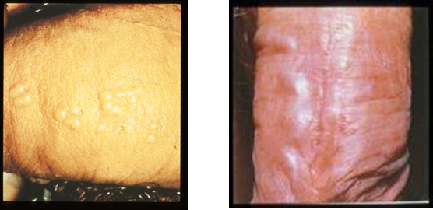
Recurrences
Majority atypical or asymptomatic
Short-lived/ occasionally warning (prodrome)
Rapid evolution from erythema to papule to blister-ulcer
Usually unilateral, less then 1cm²
Short-lived and heal quickly without scaring / occasional systemic features
Genital recurrences can be frequent, severe and complicated
HSV-2 more frequent then HSV-1 in the genitals

Slide 12
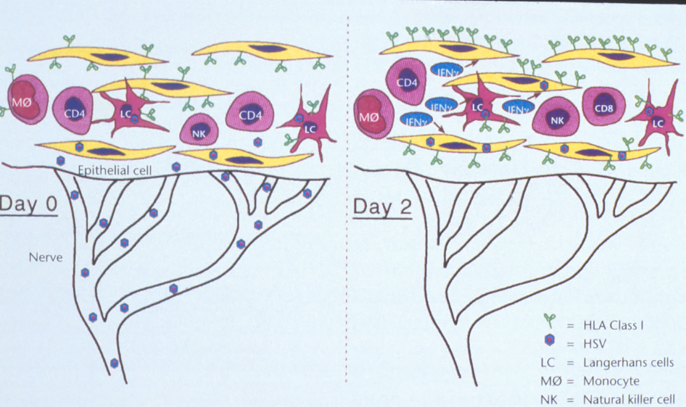

Slide 13
HIV-HSV co-infection
HSV recurrence tends to be more frequent: 300% more shedding
Multiple site involvement concurrently
Absence of effective cell mediated responses lead to persistence of active disease (large atypical lesions)
Ano-genital HSV-2 Reactivation Amongst HIV+ vs HIV- Men*
Similar patterns in pregnant women with much more frequent shedding
Schacker et al, J Infect Dis 1998;178:1616-1622

Slide 14
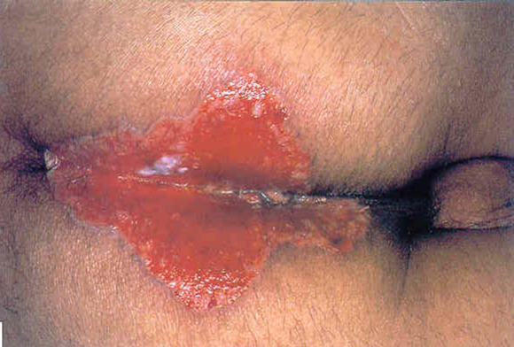
HSV - HIV Co-infection- clinically atypical
Can be Large deep ulcers
Persistent
Risk of development of resistance- can establish latency

Slide 15
Treatment Options-
Initial Infections
aciclovir 400 mg orally thrice daily for 10 days (standard dose)
aciclovir 200 mg orally five times daily for 10 days
valaciclovir 500 mg orally twice daily for 10 days
famciclovir 250 mg orally thrice daily for 10 days
Recurrent disease
aciclovir 400 mg orally thrice daily for 5 days,
800 mg twice daily for 5 days, or 800 mg thrice daily for 2 days
valaciclovir 500 mg orally twice daily for 3 days
famciclovir 250 mg twice daily for 5 days
Co-infection with HIV
aciclovir 400 mg orally thrice daily for 5 days
valaciclovir 500 mg orally twice daily for 5 days
famciclovir 500 mg orally twice daily for 5 days

Slide 16
Recurrent genital HSV infection that are frequent, severe or cause distress
• aciclovir 400 mg orally twice daily
• valaciclovir 500 mg orally once daily
• famciclovir 250 mg orally twice daily
Dosages for people living with HIV :
• aciclovir 400 mg orally twice daily
• valaciclovir 500 mg orally twice daily
• famciclovir 500 mg orally twice daily

Slide 17
Modifying therapy in HIV Co-infection
First line drugs all require viral thymidene kinase for activation
Some evidence that if the CD4 count is restored after ARVs then standard doses of HSV antivirals can be used
Otherwise use medications at full / enhanced dose and avoid ultrashort therapies

Slide 18
Problems in Co-infection
Resistance
IRIS
Rare HSV complications
Pregnancy
Transmission

Slide 19
Problems in Co-infection - Resistance
HSV with replicate in the presence of antivirals and strains either partially or totally resistant to antivirals (usually with limited pathogenicity) will develop
Mutations in thymidase kinase and HSV viral DNA polymerase will confer resistance
HSV cleared by immune responses
These strains can became latent and will recur
Switching to alternative agents (Foscarnet, Cidofovir, Pritilavir, Imiquimod) will usually clear an infection
BUT recurrences will be resistant to 2nd line agents- in the long term you need immune restoration

Slide 20
HSV - HIV Co-infection IRIS lesions
Recurrences can be persistent and last months to years
Persist despite CD4 counts normalising
Topical immune modulators and cidofovir have been used
Excision and stitching of skin on the vulva and scrotum may be needed

Slide 21
Rare HSV related problems more common in the immune compromised
Disseminated HSV
Osephageal/ colon related ulceration
Encephalitis?
HSV keratitis?

Slide 22
Pregnancy HSV-HIV co-infection
Some studies show higher rates of HIV transmission and adverse pregnancy outcome with co-infection
Possibly only of historical significance in the age of advised universal ART in pregnancy
Tendency for earlier delivery in HIV positives suggests that any offer of HSV cover in late pregnancy should be made earlier (at 32 weeks aciclovir 400mg three times a day to term)

Slide 23
HIV-HSV – Coinfection dynamics
Co-infection associated with higher HIV viral load and more rapid CD4 decline- of historical significance in the age of recommended early ART?
Co-infection associated with increased transmissibility of HIV from those not on ART- of limited significance with early ART and the Treatment as Prevention where these effects (higher risk of HIV transmission) are not seen
Note: HIV acquisition risk can not be modified in those with HSV using aciclovir or valaciclovir: Shedding of HSV can be reduced with aciclovir but short episodes of shedding (<6 hours) persist and HIV risks remain on therapy (with associated inflammatory marker presence)
?new drugs?

Slide 24
Summary
HSV can be more troublesome in those with HIV
In advanced HIV a range of rare and severe complications of HSV can be seen
In the absence of effective ARVs for HIV, co-infection is associated with increased rates of HIV transmission and HIV progression
HSV related IRIS phenomena have been described
Resistant HSV can be extremely troublesome to manage and requires the underlying immune deficit to be improved

